Slide 1
EXTREME PROGRAMMING → TEST DRIVEN DEVELOPMENT
AN OVERVIEW OF PRACTICES AND TECHNIQUES FOR TDD in XP by Ahmad Mohsin – SE-BSCS – V- 2017

Slide 2
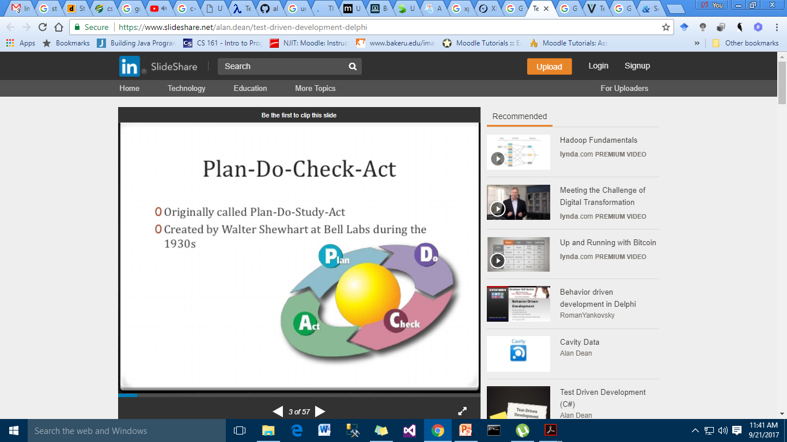
Background

Slide 3
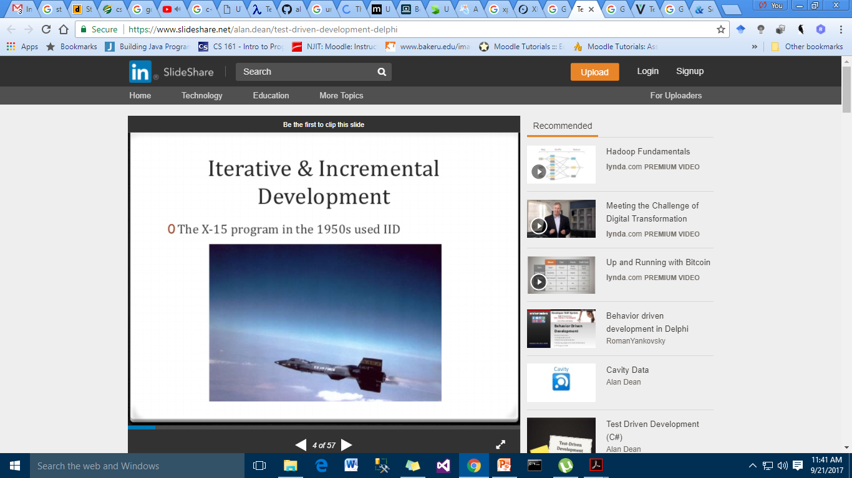

Slide 4
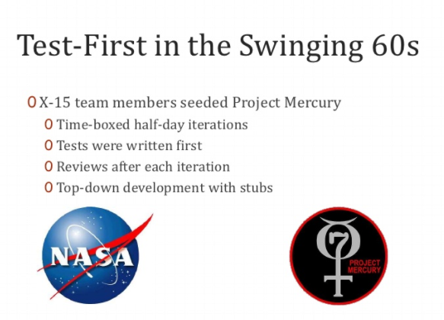

Slide 5
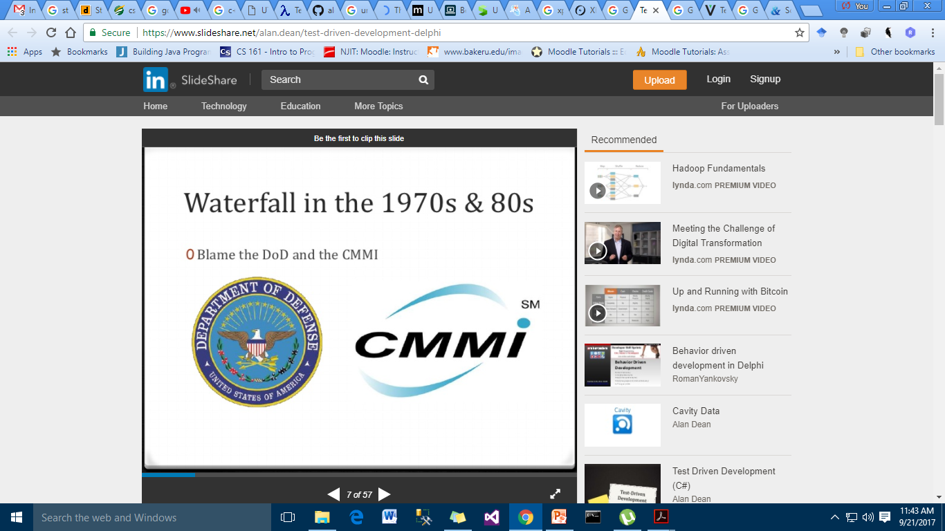

Slide 6
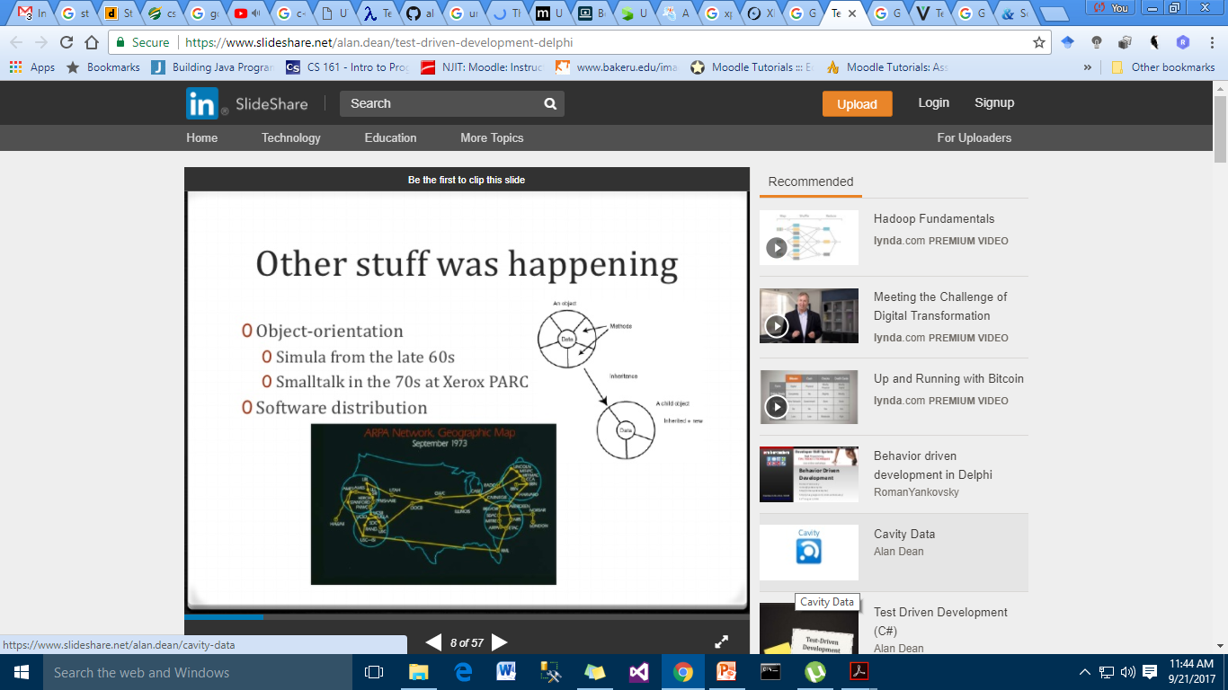

Slide 7
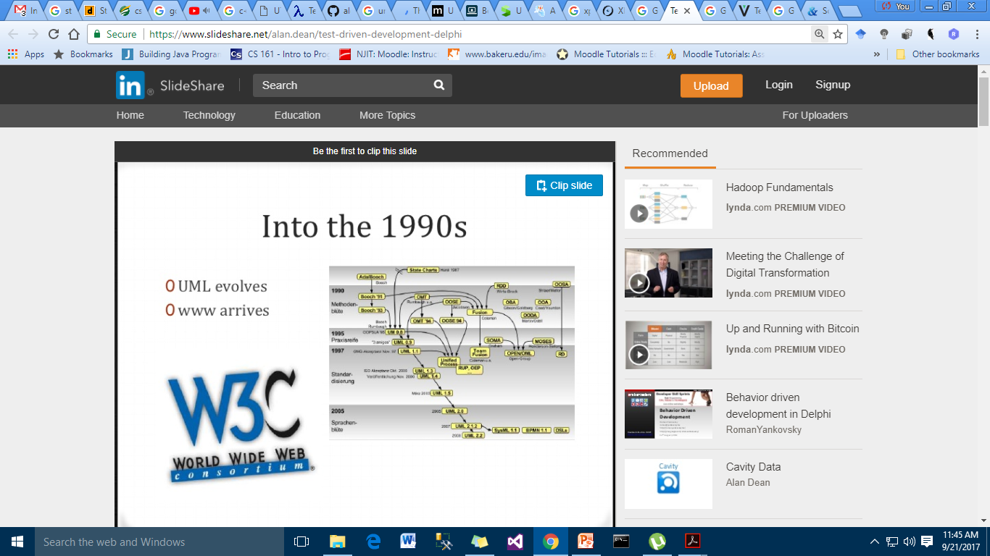

Slide 8
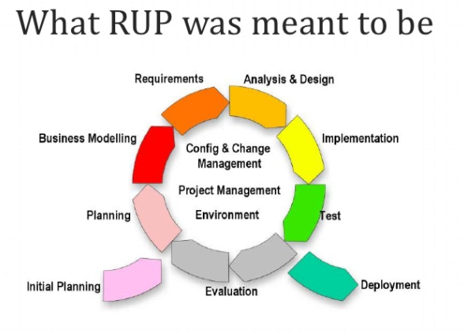

Slide 9
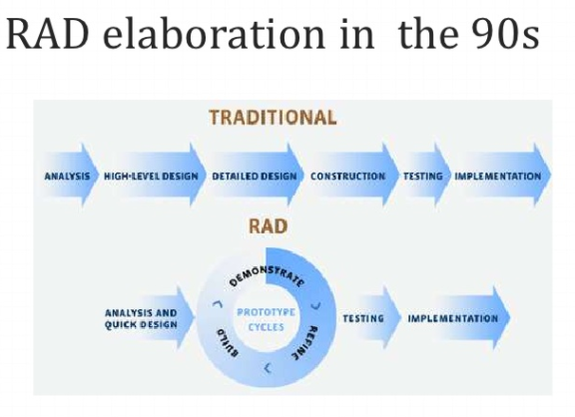

Slide 10
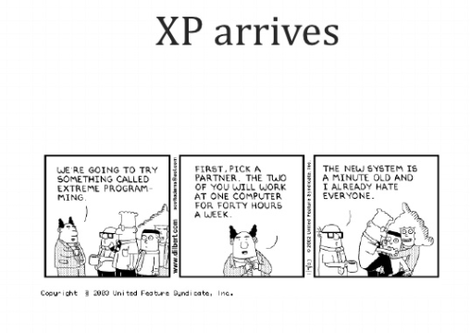

Slide 11
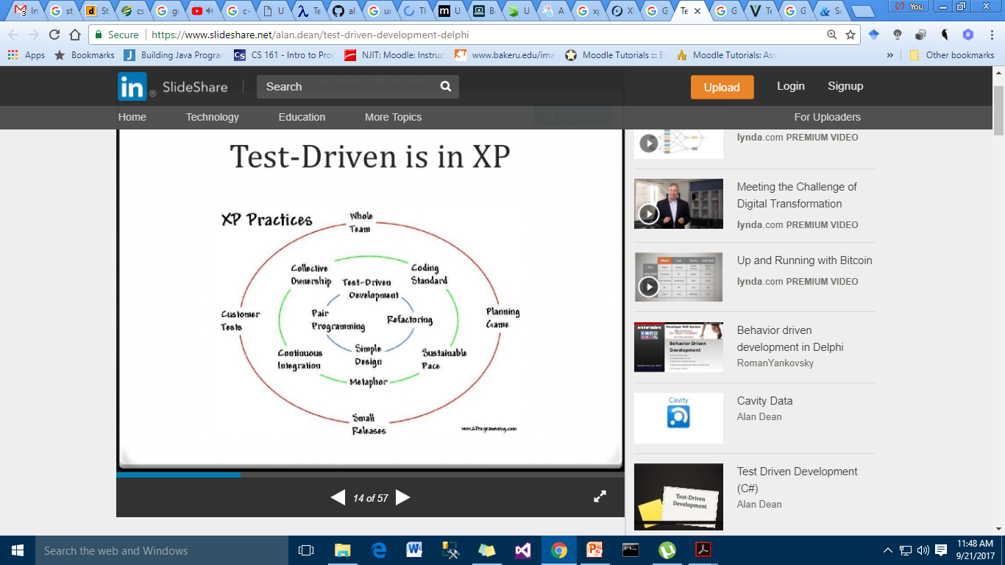

Slide 12
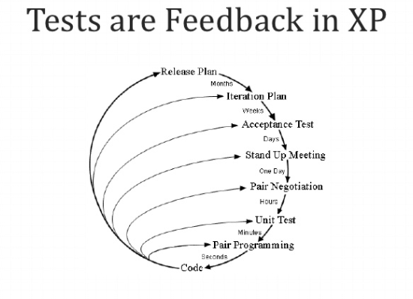

Slide 13


Slide 14


Slide 15
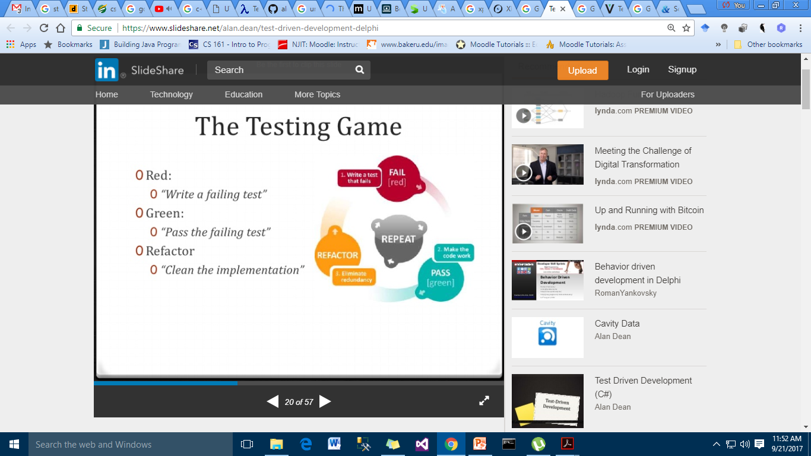

Slide 16

Red/Green/Refactor
Start
Write a test for
new capability
Refactor as needed
Compile
Run the test
And see it pass
Fix compile
errors
Write the code
Run the test
And see it fail

Slide 17
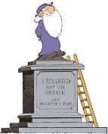
Our developer life
We are genious ! (generally misunderstood)
documented it
Turk et De Groot
We = developers
commented it
n00b
tested it
That functionality you implemented, you have ?
No, that’s useless ! It’s trivial !
…
…
… doesn’t work …
????
Notes:
What is really trivial ?
Trivial for who ? Et for how long ?

Slide 18
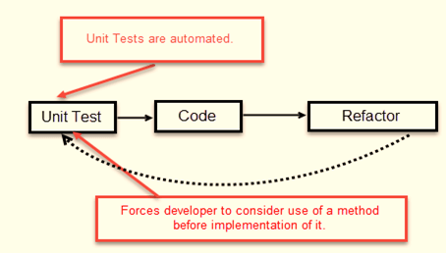
TDD
Test Driven Development (TDD) is a programming practice that instructs developers to write new code only if an automated test has failed. This avoids duplication of code. The primary goal of TDD is to make the code clearer, simple and bug free.

Slide 19
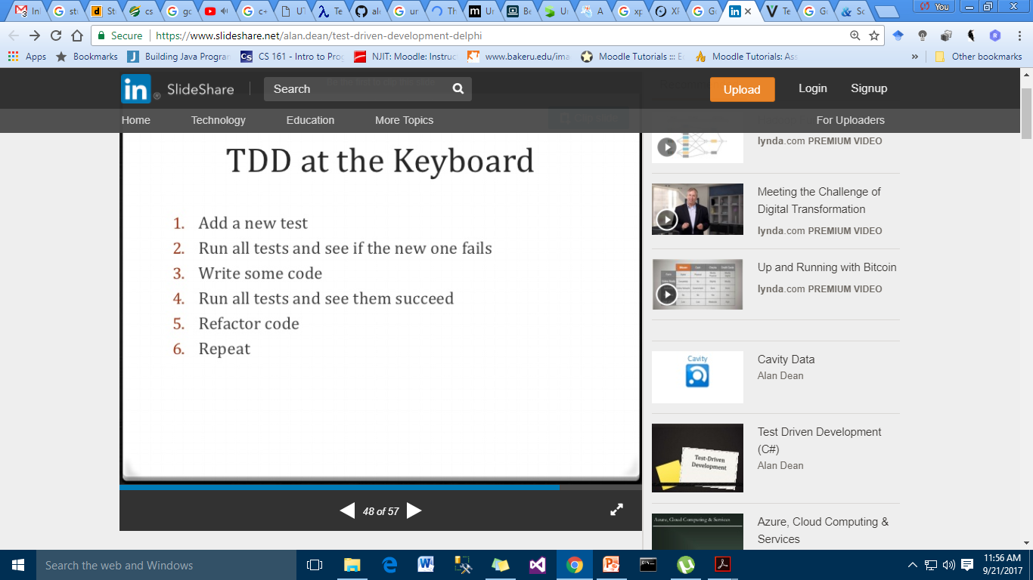
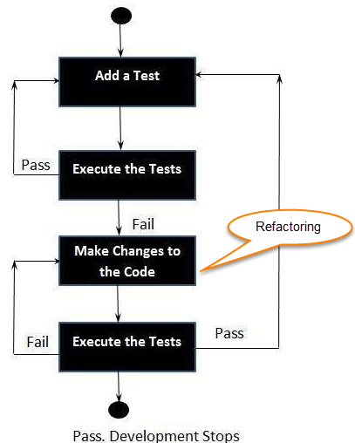

Slide 20
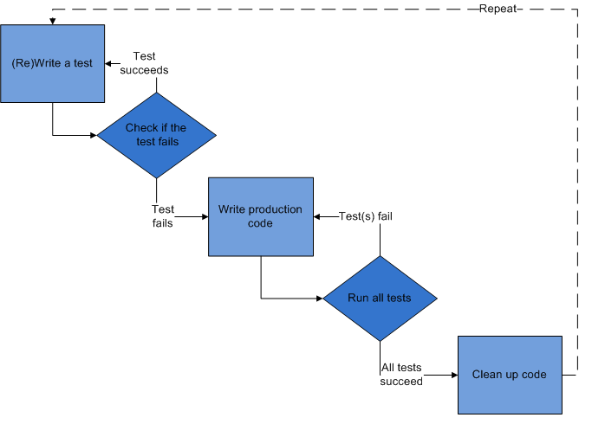
TDD - FLOW

Slide 21
What can be Tested?
Valid inputs
Invalid inputs
Errors, exceptions, and events
Boundary conditions
Everything that could possibly break!

Slide 22
Code Refactoring

Slide 23
Refactoring – cont.…
Change the internal structure of the code without changing it’s external behavior.
Associated with arithmetic factorization:
ab + ac = a(b+c)
Same result but the expression is simplified.

Slide 24
Unit Testing Framework
To simplify development of unit tests, unit test frameworks are usually used. Unit testing framework should provide following functionality:
Writing of unit tests should be simple and obvious for new users.
Framework should allow advanced users to perform nontrivial tests.
Test module should be able to have many small test cases and developer should be able to group them into test suites.
At the beginning of the development users may want to see verbose and descriptive error message, whereas during the regression testing they may just want only to know if are any failed tests.
For small test modules execution time should prevail over compilation time: users don't want to wait a minute to compile a test that takes a second to run.
For long running and complex tests users may want to be able to see the test's progress.
Execution of individual tests should be independent on other tests. For example, termination (crashing) of one test shouldn't lead to skipping of all other tests.
Simple tests shouldn't require an external library.

Slide 25
Each of such frameworks consists from:
Assertions, that check individual conditions;
Test cases, that combine several assertions, based on some common functionality;
Test suites, that combine several tests, logically related to each other;
Fixtures, that provide setup of data or state, needed for execution of some tests, and cleanup of state and/or data after test is finished. (Some frameworks provide separate per-test case, per-test suite, and/or global fixtures)
Frameworks also include execution monitor, that controls how tests are executed, and collects data about failed tests.

Slide 26
Minimal test program
Here is minimal example, that defines one test:
#define BOOST_TEST_MODULE
#include <boost/test/unit_test.hpp>
BOOST_AUTO_TEST_CASE(simple_test)
{
BOOST_CHECK_EQUAL(2+2, 4);
}

Slide 27
Results
you can also control verbosity of output with execution monitor's options — see below):
Running 1 test case... *** No errors detected If something will go wrong, then framework will print another message on the screen:
Running 1 test case... test-simple.cpp(5): error in "simple_test": check 2+2 == 5
failed [4 != 5] *** 1 failure detected in test suite "Simple testcases"

Slide 28
Checks
int i = 2; int j = 1;
BOOST_CHECK( i == j );
BOOST_CHECK_EQUAL( i, j );
the first checker will only report that check was failed:
test.cpp(4): error in "test": check i == j failed while the second checker, will report about problem, together with actual values, used in comparison:
test.cpp(5): error in "test": check i == j failed [2 != 1]

Slide 29
Assertions
an assertion is a statement that a predicate (Boolean-valued function, a true–false expression) is expected to always be true at that point in the code. If an assertion evaluates to false at run time, an assertion failure results, which typically causes the program to crash, or to throw an assertion exception.
The following code contains two assertions, x > 0 and x > 1, and they are indeed true at the indicated points during execution:
x = 1;
assert x > 0;
x++;
assert x > 1;

Slide 30
Assertion Functions
Libraries may provide assertion features as well.
#include <assert.h>
int f(void)
{
int x = 5;
x = x + 1;
assert(x > 1);
}

Slide 31
Assertions for run-time checking
int total = countNumberOfUsers();
if (total % 2 == 0)
{ // total is even
}
else
{
// total is odd and non-negative assert total % 2 == 1; }

Slide 32
% is the remainder operator (modulo), and if its first operand is negative, the result can also be negative (unlike the modulo used in mathematics). Here, the programmer has assumed that total is non-negative, so that the remainder of a division with 2 will always be 0 or 1. The assertion makes this assumption explicit: if countNumberOfUsers does return a negative value, the program may have a bug.
A major advantage of this technique is that when an error does occur it is detected immediately and directly, rather than later through its often obscure side-effects. Since an assertion failure usually reports the code location, one can often pin-point the error without further debugging.

Slide 33
References
Kent Beck: Agile software development: principles, patterns, and practices. Addision Wesley, 2003 I Astels
Test Driven Development: A Practical Guide, Prentice Hall, 2003.
https://www.guru99.com/test-driven-development.html.
http://alexott.net/en/cpp/CppTestingIntro.html

